Slide 1
Meetify Midterm Progress
CS Senior Design 2020

Slide 2
Group Members
Dustin Seger - dustin.seger@hotmail.com
Jake Steuver - jakesteuver@gmail.com
Rob Boeckermann - robboeckermann@gmail.com
Bret Patton (advisor) - bret.patton@ymail.com

Slide 3
Project Purposes & Goals
In this day and age, there are countless ways to meet people and listen to music online, but very few places to do both!
Thus, our team wanted to create an app to combine these concepts, allowing users with like music interests to meet.
Although some vaguely similar apps are out there, we have found them to be unpopular and/or no longer supported. We think that, by tying it to the Spotify music library, we will be able to reach more people and create a vast network for people to meet!

Slide 4
Project Abstract
What is Meetify?
A cross-platform application and website
Matches users based on their musical tastes
Will allow users to then message each other in-house
Users’ musical tastes are pulled from their Spotify accounts
Thus the name “Meetify” :)
How will it work?
MySQL database
Python-based server (via Django)
HTML/JS web-based application (via React)
Written as website; distributed to all major platforms

Slide 5
User Stories
As a Meetify user, …
… I want to match with other users based on our musical tastes, so that I can meet people that have similar music tastes to my own.
… I want to be able to see what musical similarities caused me to match with another user and a “playlist intersection” of our Liked Songs, so that me and my match have concrete similarities we can discuss.
A “playlist intersection” is a playlist containing only songs found on both input playlists.
… I want to be able to use the service to communicate with users I match with, so that I do not need to give out my personal contact info.

Slide 6
User Stories (cont.)
As a Meetify user, …
… I want other users’ profiles to show some public information (unrelated to music), so that I have some general information about my matches.
… I (optionally) want to be able to filter matches based on proximity, so that I can match with people close to me if I am looking to meet people in person.
As a Meetify developer, …
I want to be able to see what musical similarities caused any two anonymous users to match, so that I can know that the algorithm is accurate.

Slide 7
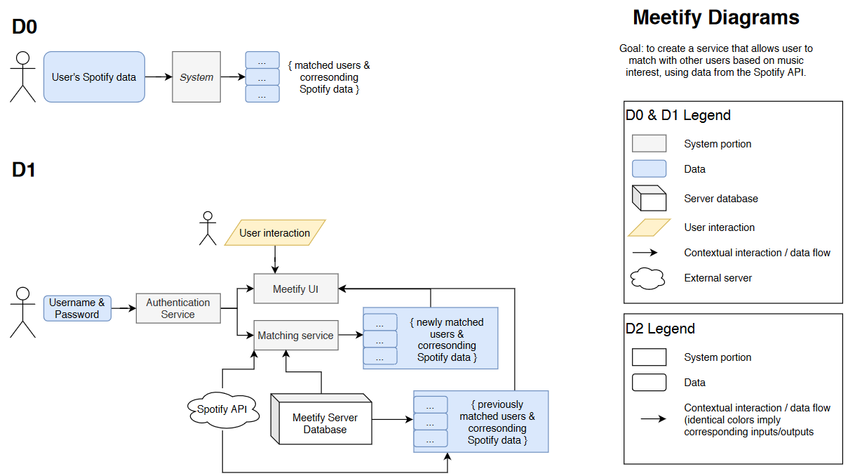
Design Diagrams

Slide 8
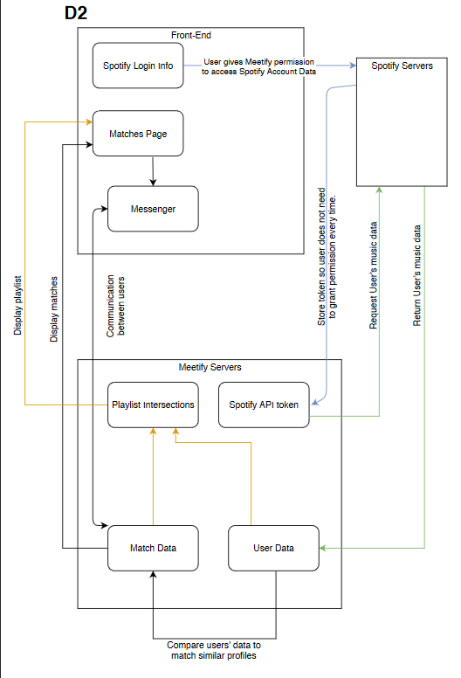
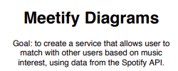
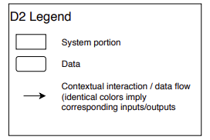
Design Diagrams (cont.)

Slide 9
Major Project Constraints
Time
Need to find time between classes and looking for full-time jobs
Limit and/or prioritize features
Scope
Everyone understands their role in the project
Those roles may change based on changes to the scope of the project
Technical Experience
Will be using several unfamiliar technologies/skills
Django, React Native, JavaScript, Spotipy, Encryption, Database management, and server deployment
Need to spend time learning these, which affects how long the overall project takes

Slide 10
Major Project Constraints (cont.)
Legal
Bound to the Spotify API’s Developer Terms of Service
Cannot make money off of our service without permission from Spotify
Security
Personal data (passwords, names, Spotify data)
Need to keep our application secure since it interacts with the user’s Spotify account
Location services need protected
Social
Guided by the goal of bringing people together based on music tastes

Slide 11
Major Project Constraints (cont.)
Environmental
Deployment to different platforms
Server located in Rob’s place of residence
Diversity and Cultural Impact
More of “expansions” rather than “constraints”
Support multiple languages
Support accessibility features
Supporting other countries (e.g. certain songs may be unavailable in certain countries)

Slide 12
Progress
Created MySQL database with prototype tables and stored procedure for intersecting two users’ liked songs.
Created Django server with python code that authenticates a user’s Spotify account, saves their userID and the songIDs of their liked songs to our database, and receives requests for Liked Song intersections from the front-end.
Created React front-end that requests an intersection of Liked Songs and outputs them to the user.

Slide 13
Term Goals
Expected Accomplishments for the end of this term:
Migrate our database, Django server, and web-based application to our own server to avoid cloud expenses.
Link our application to our domain name, “Meetify.tech”.
Fully design and implement the database structure.
Add support for Meetify logins.
Create an algorithm for comparing Spotify data of users and matching them accordingly.

Slide 14
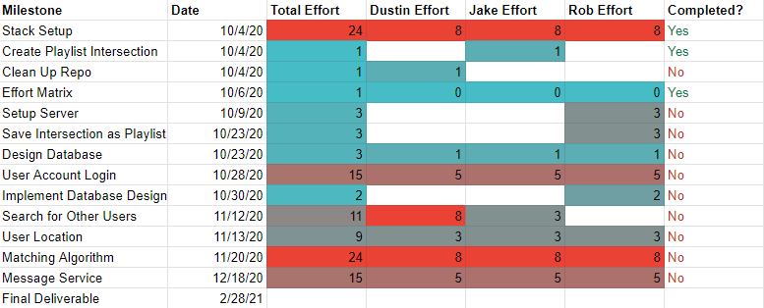
Division of Work

Slide 15
Expected Demo
Talk about the idea for Meetify and how it works.
Explain our original goals for the project and whether we met all of them.
Show the design of our database and what kind of information we keep.
Run a demo on the front end where we:
Create a new user account.
Grant permission for Meetify to access the user’s spotify account.
Search for matches with existing users.
Display the matches, the profile information of the matches (including location), what made the users match, and the “Playlist Intersection” of their Liked Songs.
Start a text conversation with one of the matches.
Create a Playlist Intersection with someone I didn’t match with, but whos Spotify username of userID I know.

